Slide 1

END SEMESTER B.TECH
MINI PROJECT
FINAL EVALUATION
SAINTGITS
COLLEGE OF ENGINEERING
(AUTONOMOUS)
LEARN . GROW . EXCEL

Slide 2
SAINTGITS
COLLEGE OF ENGINEERING
(AUTONOMOUS)
Project Area : | Embedded AI for Assistive Applications
Proposed Project Title : | AI-Assisted Wearable Mobility Aid for Visually Impaired
Project Guide
Er. Anish M George
Assistant Professor (Senior)
Details of Team Members
1. Afna A (MGP23ECE006)
2. Aswin S (MGP23ECE018)
3. Ebin Soyan Thomas(MGP23ECE020)
4. Juliya Augustine (MGP23ECE033)
LEARN . GROW . EXCEL

Slide 3
CONTENTS
    TOPIC IDENTIFICATION
    SCOPE AND FOCUS OF THE PROJECT
    OBJECTIVES
    CONSOLIDATION OF LITERATURE REVIEWS
    COMPONENTS
    BLOCK DIAGRAM
    CIRCUIT DIAGRAM
    WORK PROGRESS
    TIMELINE OF PROJECT
    MEMBER ROLES
    CHALLENGES
    CONCLUSIONS
    REFERENCES

Slide 4

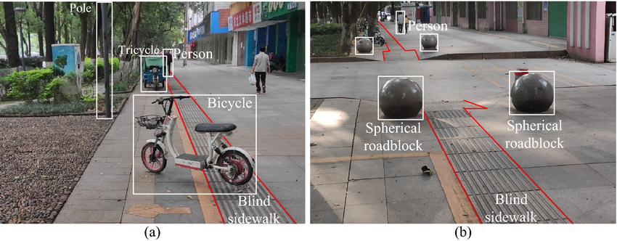
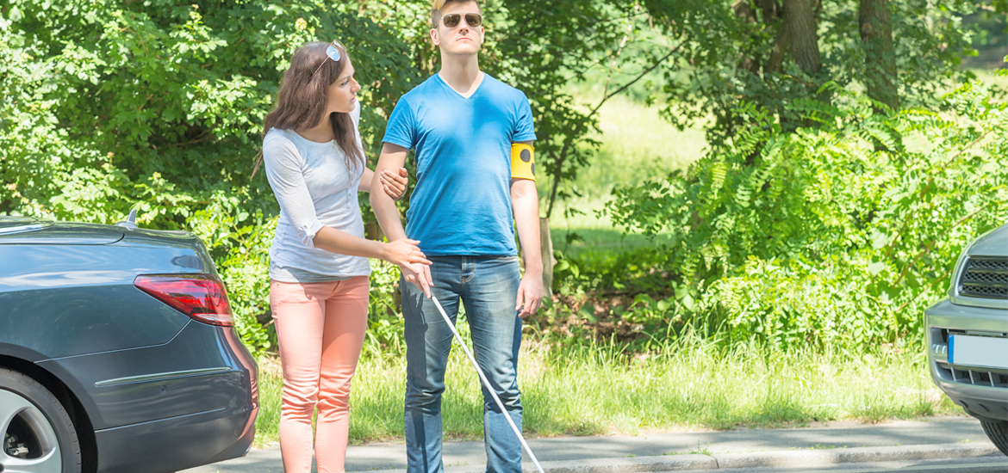
Introduction
Visual impairment has been a major challenge for a long time, and the inability to perceive surroundings in real-time significantly affects safe and independent navigation.
Traditional mobility aids such as white canes can detect obstacles but cannot identify objects or provide detailed environmental information.
Lack of real-time object recognition increases the risk of accidents and limits the confidence of visually impaired individuals during movement.
The proposed system combines computer vision with ultrasonic sensing to improve obstacle awareness and environmental understanding.
This project aims to overcome these limitations by providing a low-cost, real-time assistive system using object detection and audio feedback.
LEARN . GROW . EXCEL

Slide 5
Scope and Focus of the Project
Application Scenario
  Assistive Navigation for Visually Impaired Individuals
Technology Sector
  Embedded Systems, Computer Vision, and Machine Learning
Main Focus
  Real-time Assistive Navigation using Embedded AI, Sensor Fusion, and Audio Guidance
LEARN . GROW . EXCEL

Slide 6
Objectives of the Project
Detect objects in real-time using camera-based vision
Identify objects using AI-based image processing.
Provide audio feedback for safe navigation
Improve obstacle detection using sensor fusion and distance estimation
LEARN . GROW . EXCEL

Slide 7
Consolidation of Literature Review in Phase 1
S.NO | LITERATURE REVIEW | TYPE OF ALGORITHM | EFFICIENCY OF PREDICTION
1 | Wearable Navigation Device for Visually Impaired People | SLAM + RGB-D + Semantic Segmentation | 90%
2 | Review of Assistive Navigation Systems for Blind People | Multi-modal sensing (GPS, IoT, Camera-based systems) | 75%
3 | Intelligent Navigation Assistance for Visually Impaired | Deep Learning + NAS | 92%
LEARN . GROW . EXCEL

Slide 8
Consolidation of Literature Review in Phase 2
S.NO | LITERATURE REVIEW | TYPE OF METHOD | EFFICIENCY OF PREDICTION
3 | Real-Time Object Detection using YOLO for Assistive Navigation | Deep Learning (YOLO) | 90%
4 | Ultrasonic Sensor Based Navigation Aid for Visually Impaired | Ultrasonic Sensing | 70%
5 | Smart Glasses for Visually Impaired with AI Detection | Embedded AI + Camera | 87%
LEARN . GROW . EXCEL

Slide 9
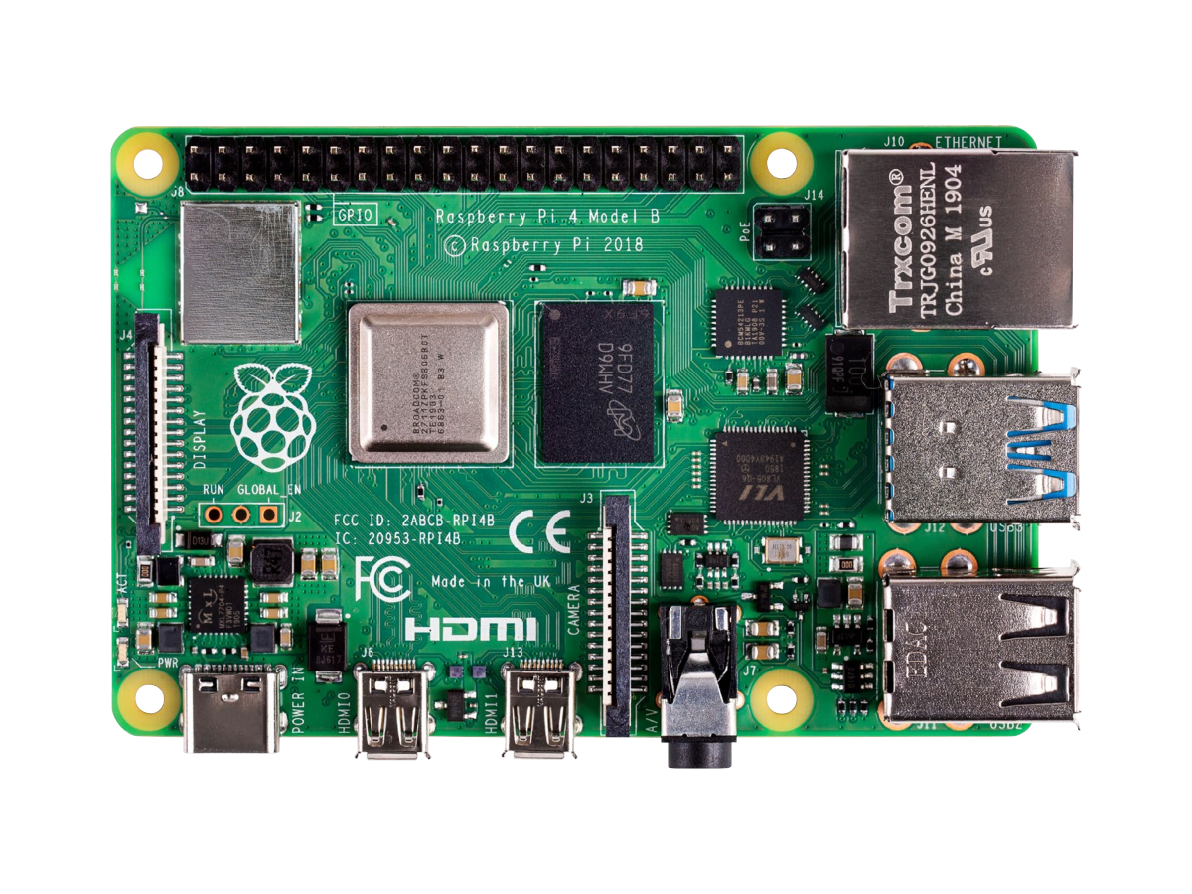
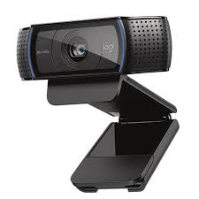
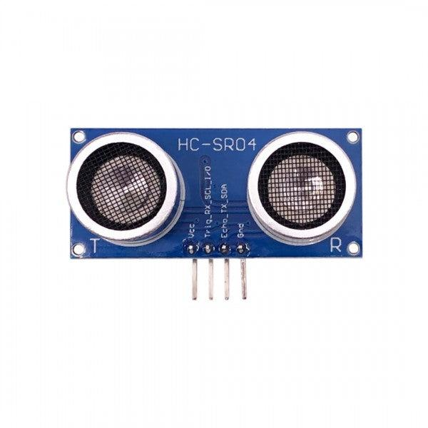
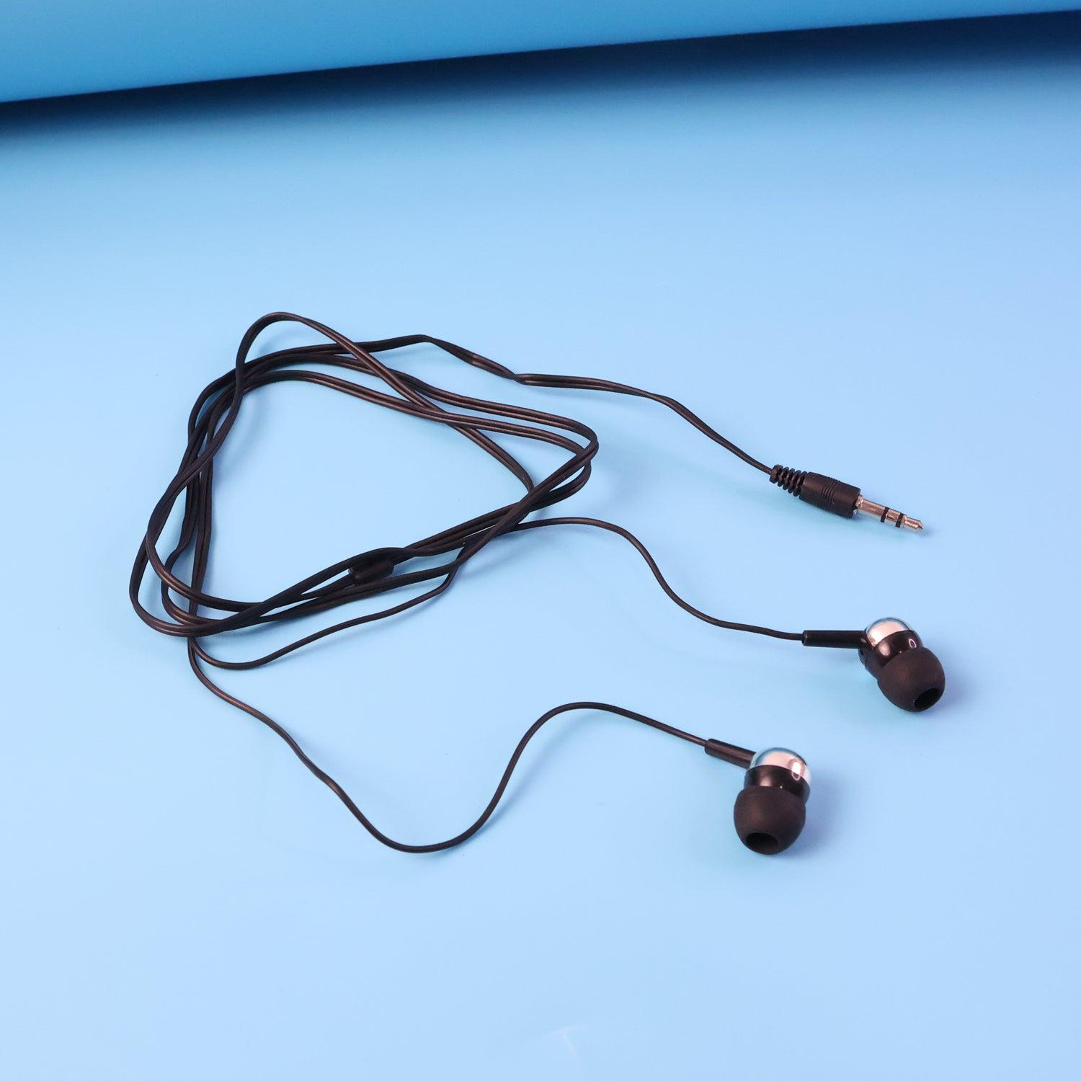
Components Used
HARDWARE COMPONENTS
1 Raspberry Pi 4 (4.5k)
2 USB Webcam
3 Earphones (Audio Output)
Power Supply / Power Bank (5000 mah)
HC-SR04 Ultrasonic Sensor
Voltage Divider Resistor Circuit (1k,2k)
LEARN . GROW . EXCEL

Slide 10


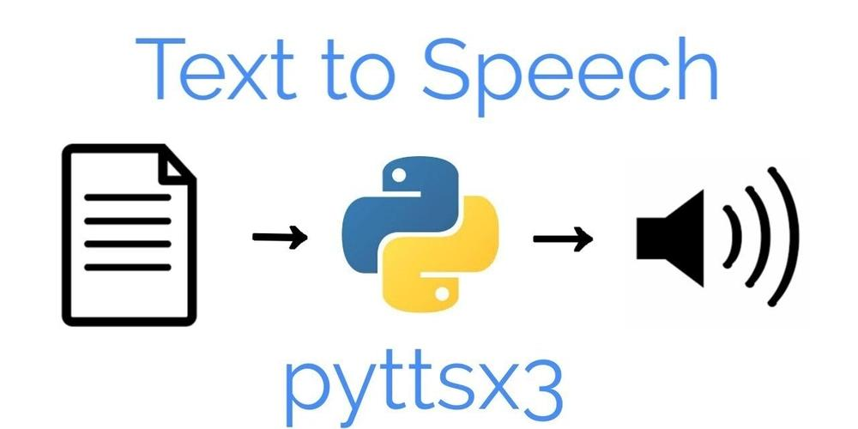

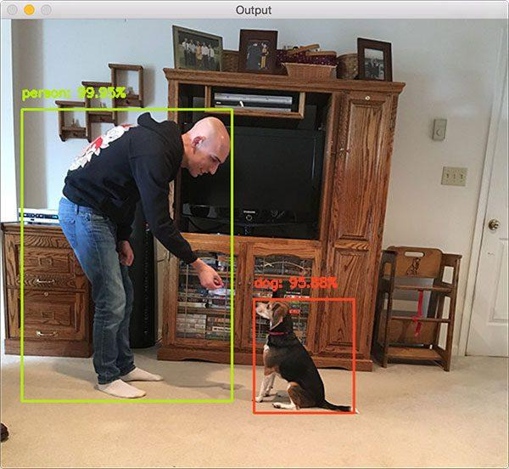
Components Used (Contn..)
SOFTWARE COMPONENTS
Raspberry Pi OS (Bookworm – 32-bit)
Python (Virtual Environment – blind_env)
OpenCV (Image Processing)
TensorFlow Lite (Object Detection)
SSD MobileNet COCO Model (detect.tflite)
Label File (labelmap.txt)
Text-to-Speech Library (pyttsx3 / espeak)
RPi.GPIO
Detection Voting Algorithm
Sensor Fusion Logic
LEARN . GROW . EXCEL

Slide 11
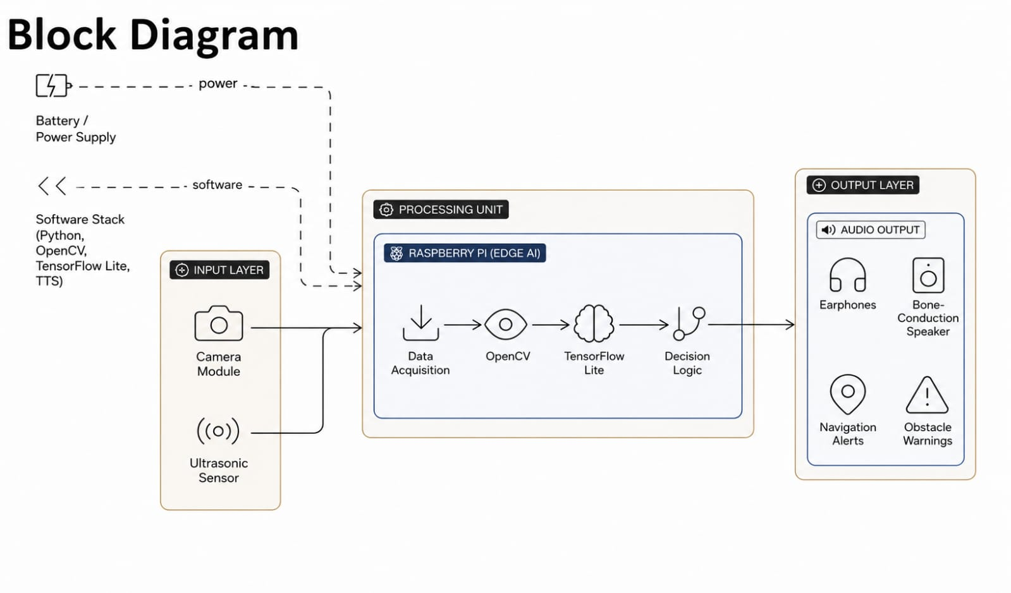
LEARN . GROW . EXCEL

Slide 12
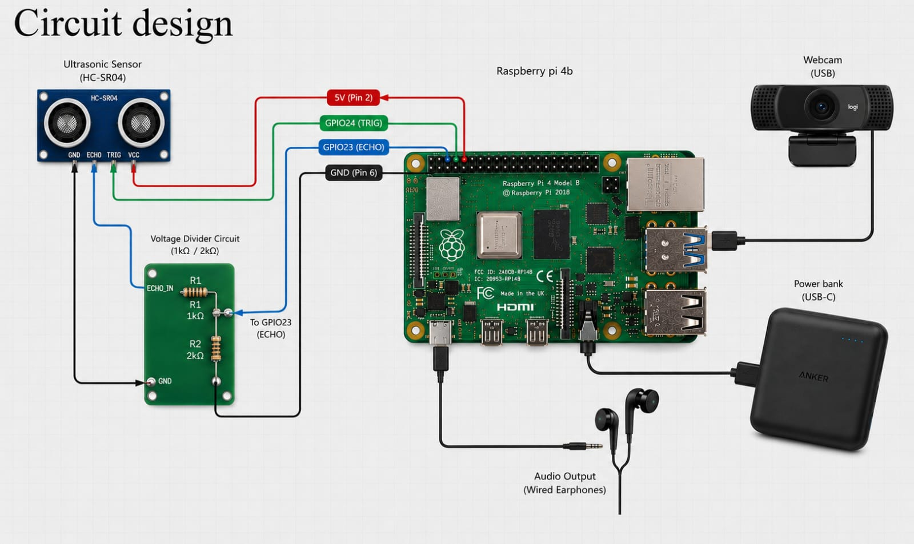
Circuit Diagram
LEARN . GROW . EXCEL

Slide 13
Work Progress : Software Development
The system continuously captures video frames and performs real-time object detection using TensorFlow Lite.
Bounding box analysis and center filtering are used to prioritize important obstacles.
Ultrasonic sensing is integrated for practical distance classification into near, medium, and far categories.
LEARN . GROW . EXCEL

Slide 14
Work Progress : Software Development(Contn..)
A temporal voting mechanism is implemented to reduce false detections by validating repeated object detections within a finite time window.
Frame skipping and lightweight inference optimization improve real-time performance on Raspberry Pi 4.
A cooldown mechanism prevents repetitive audio announcements and improves user experience.
LEARN . GROW . EXCEL

Slide 15
Work Progress : Software Development
Flowchart
Camera Capture
+
Ultrasonic sensing
TensorFlow Lite Interface
Frame Preprocessing
Object Detection
Bounding Box Filtering
Audio Guidance
Text-To-Speech Output
Direction Detection
Distance Classification
Detection Voting System
LEARN . GROW . EXCEL

Slide 16
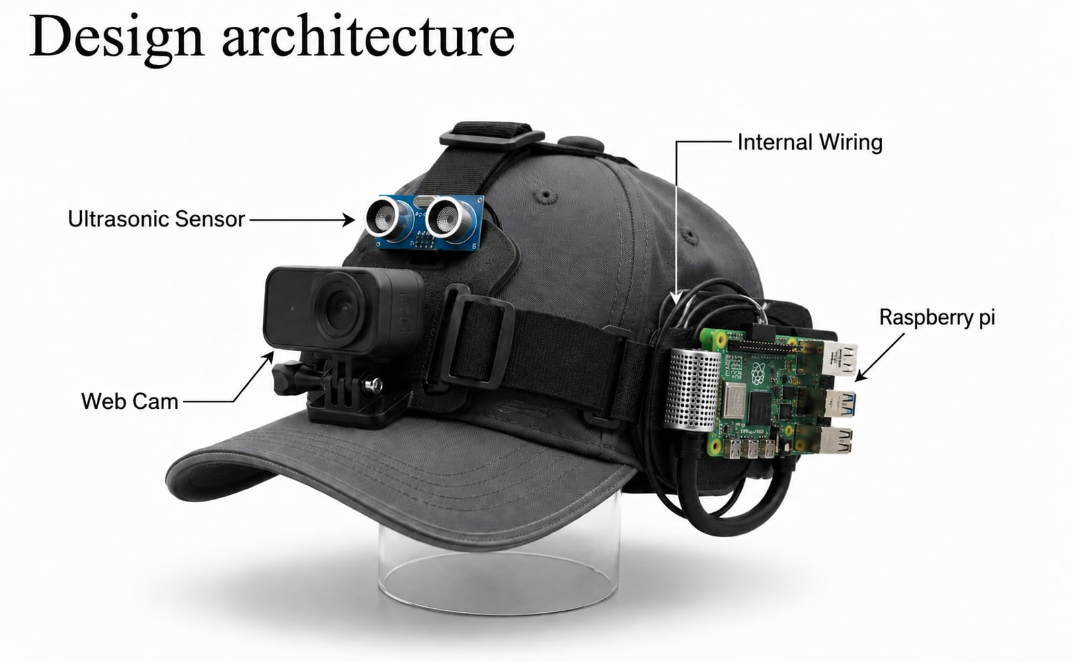
Work Progress : Model of Hardware Prototype
ATMEGA 328P
LEARN . GROW . EXCEL

Slide 17

Total Cost of Prototype
Raspberry Pi 4 Model B (4GB) Rs:4500
Case with Cooling Fan Rs:670
HP USB Webcam Rs:800
Earphones Rs:450
Power Bank(2000mah) Rs:1500
Ultrasonic sensor Rs:120
Resistors and wiring Rs:50
Total Estimated Cost: 10,590
LEARN . GROW . EXCEL

Slide 18
Member Roles
Member 1 (Afna A)
Research on components and their specifications, implementation methods,
and literature review.
Member 2 (Aswin S)
Coding and study of software components,
hardware design, and system integration.
Member 3 (Ebin Soyan Thomas)
  Dataset collection, coding of software components, and literature review.
Member 4 (Juliya Augustine)
  Dataset collection, system setup and
  installation, documentation, and literature review.
LEARN . GROW . EXCEL

Slide 19
Challenges
Ultrasonic Sensor Integration
Voltage compatibility handling using resistor divider circuit.
Detection Stability
Reducing false detections in dynamic environments.
Real-Time Optimization
Balancing FPS and inference speed on Raspberry Pi 4.
Wearable Prototype Design
Maintaining portability and user comfort.
Sensor Synchronization
Combining ultrasonic sensing and AI inference efficiently.
LEARN . GROW . EXCEL

Slide 20

TIMELINE
PHASE - 1
TASK | WEEK 1 | WEEK 2 | WEEK 3 | WEEK 4 | WEEK 5 | WEEK 6 | WEEK 7 | WEEK 8
IDEA FINALISATION
REFERANCE PAPER COLLECTION
LITERATURE SURVEY
INSTALLATION
DATASET COLLECTION
INTEGRATION
TESTING & RUNNING
REPORT
DURATION
LEARN . GROW . EXCEL

Slide 21
TIMELINE
PHASE - 2
Jan
Feb
Mar
Completion of training model
Prototype design
Integration of hardware and software
Final testing and running
LEARN . GROW . EXCEL

Slide 22
Conclusion
The proposed system successfully integrates Embedded AI, Computer Vision, and Sensor Fusion techniques to assist visually impaired users in real-time navigation.
By combining TensorFlow Lite object detection with ultrasonic distance sensing, the system provides reliable obstacle identification along with practical distance awareness.
The implementation of temporal voting, direction-aware guidance, and optimized real-time inference significantly improves detection stability and user experience.
Lightweight optimization techniques enable efficient deployment on Raspberry Pi 4 hardware, making the system portable, low-cost, and suitable for real-world assistive applications.
The project demonstrates how Edge AI and embedded systems can enhance independent mobility, safety, and environmental awareness for visually impaired individuals.
LEARN . GROW . EXCEL

Slide 23
References
[1] Howard, Andrew G., et al. “MobileNets: Efficient Convolutional Neural Networks for Mobile Vision Applications.” 2017.
[2] TensorFlow Team. “TensorFlow Lite for Mobile and Embedded Devices.” Google Developers, 2023.
[3] OpenCV Organization. “Open Source Computer Vision Library.” https://opencv.org/
[4] Raspberry Pi Foundation. “Raspberry Pi 4 Model B Documentation.” 2023.
[5] eSpeak NG Developers. “eSpeak NG Text-to-Speech System.” https://github.com/espeak-ng/espeak-ng
LEARN . GROW . EXCEL

Slide 24

LEARN . GROW . EXCEL

